Slide 1


  Strategies to Support
  Job Coaches and CBDS Staff
  in the Pursuit of Competitive Integrated Employment
Jeff Gentry and Suzanne Henderson

Slide 2
Session Overview
  Introductions
  Audience Poll
  Reflect on the Need to Develop the Workforce for Workforce Development
  Explore:
    Tools for Training and Supporting Coaches
    Ideas for Strengthening the Impact of Staff Training
  Understand Concepts for Cultivating Competent Teams
Notes:
Poll: What is your primary role (you can choose more than 1)? Program Director, Manager or Supervisor, Job Coach/Employment Staff, Direct Care Staff, Families, Self-Advocate

Slide 3
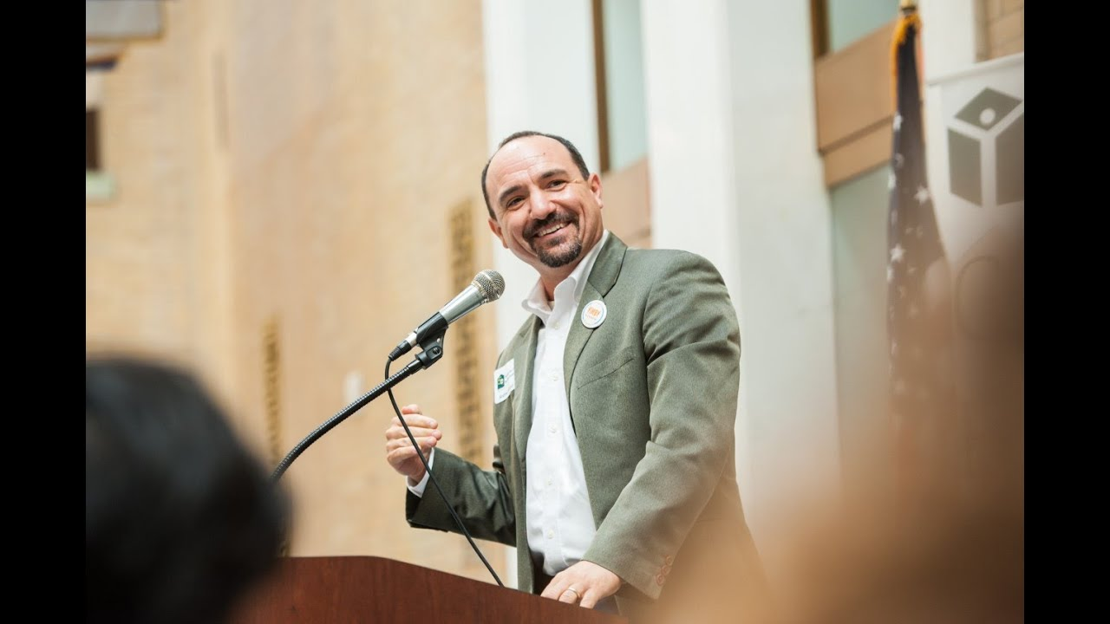
“The HOW is
as important
as the WHAT.”
-Andrew DeFranza
CEO, Harborlight Homes
Notes:
I always thought that goals were the sole driver of outcomes
What I’ve learned is that even passionate people need to be equipped to do this work
Today, I am going to try to talk about a few of the ways I have tried to develop workforce developers. And Suzy is going to make suggestions about how I could have done it more intelligently

Slide 4
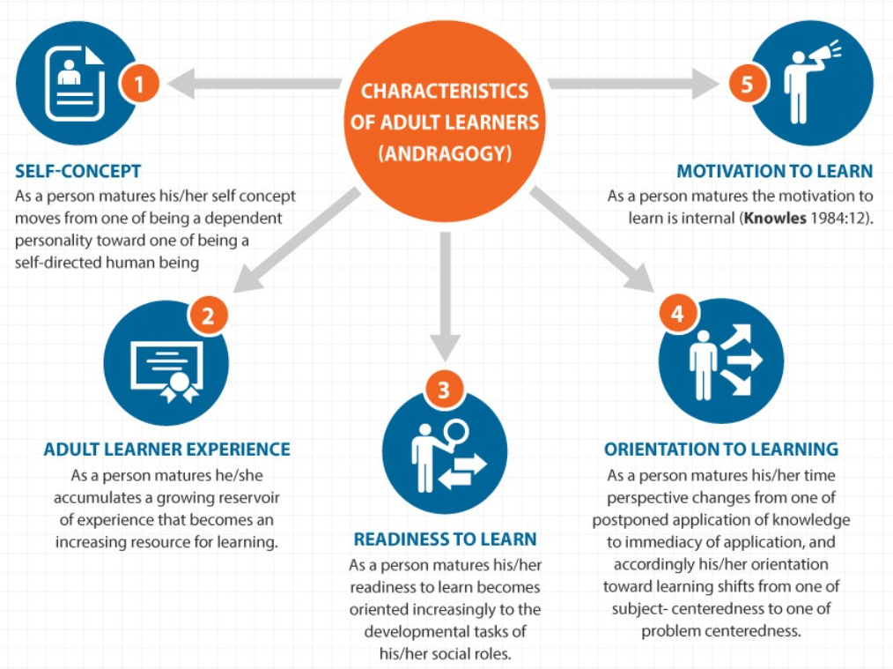
Adult Learning: We’re Doing It Wrong
Knowles’ 5 Assumptions of Adult Learners
Knowles, M. (1984). The Adult Learner: A Neglected Species (3rd Ed). Houston, TX: Gulf Publishing.
The Adult Learning Theory - Andragogy - of Malcolm Knowles - eLearning Industry

Slide 5
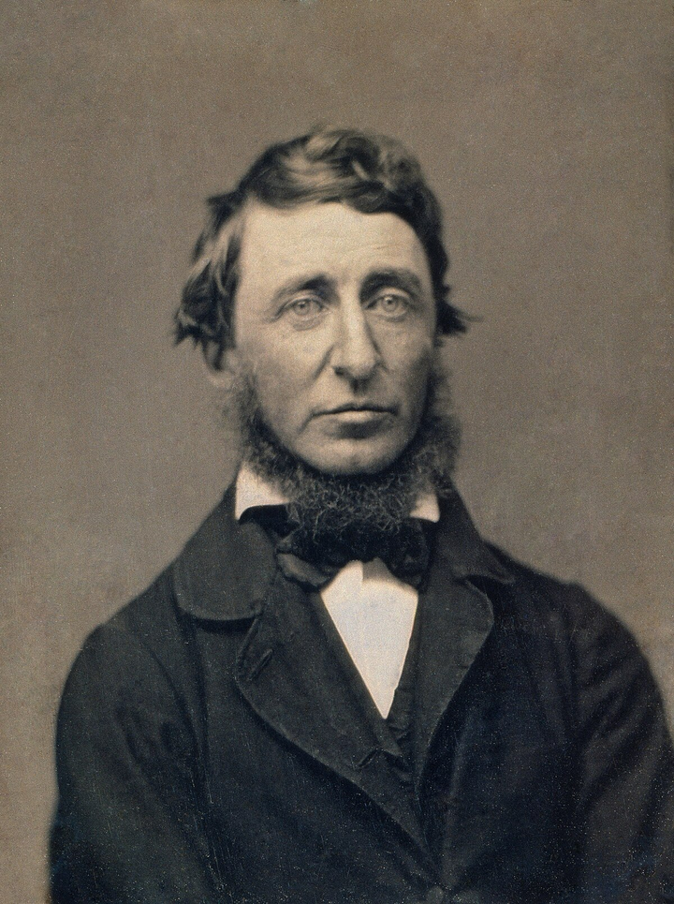

Stages of Competitive Integrated Employment Services
Career Exploration
Skills Development
Job Development + Placement
Initial Employment Supports
Ongoing Supports
“Simplify, simplify, simplify”
Notes:
Slow learning.
It’s

Slide 6
  Making the Stages Actionable: A Guidebook (sample)
CAREER EXPLORATION | JOB DEVELOPMENT & PLACEMENT
Required Activities: Ensure Intake Meeting has been completed & documented Review and sign standard Client & Career Coach Agreement Create a MassCIS Account with Client & complete MassCIS Interest Profiler Assessment. Discuss results. Explore Occupations on MassCIS website Explore job descriptions Conduct a mock interview Review client’s cover letter & resume Personal reference check Professional reference check Complete “Life Trajectory Worksheet” with a focus on employment Complete Initial Career Plan document Assess client’s readiness for Skills Development or Job Development & Placement | Required Activities: Ensure Intake Meeting has been completed & documented Review and sign standard Client & Career Coach Agreement Identify Client support team members Complete meeting plan Discuss strategies for job search Pursuing Employment via Job Search Chart Guardianship verification & work documentation CORI issues identified and addressed Identify benefits, discuss how earnings can be reported & refer to benefits counseling as appropriate Create MassHire Job Seeker ID, MassCIS Account and MHDB Membership Identify Career Goals Identify Accommodations
Notes:
Footnotes to certification indicators.

Slide 7

Learning Considerations: Guidebook
  Learning aid for just in time learning
  Provides “why” for learning, links to staff experience, solves problems
  Feature one section at a time (brief staff meeting review, weekly email, etc. -- retrieval to reinforce learning)
Turn & Talk:
How do you see yourself using the guidebook with your team?

Slide 8
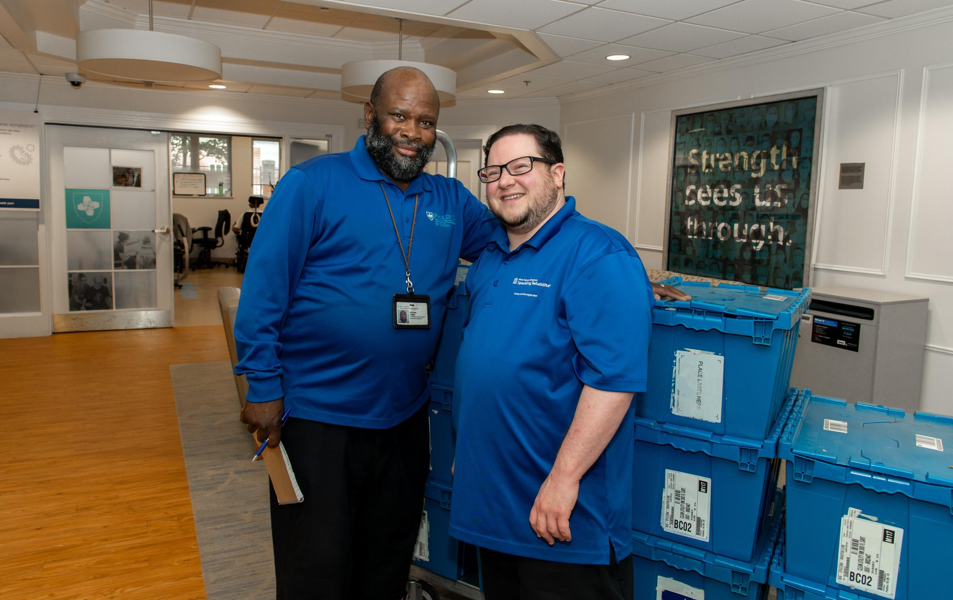
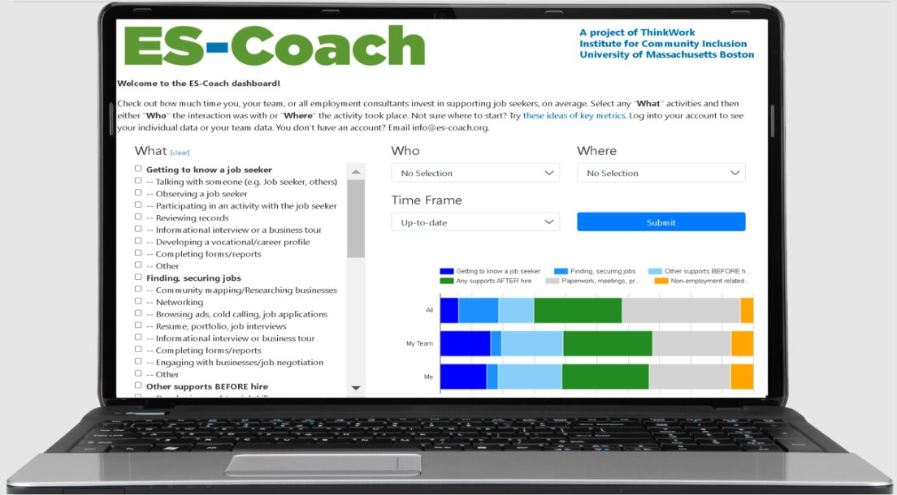
Tracking Our Investments in People’s Careers: ES-Coach (i.e., a clever way)

Slide 9
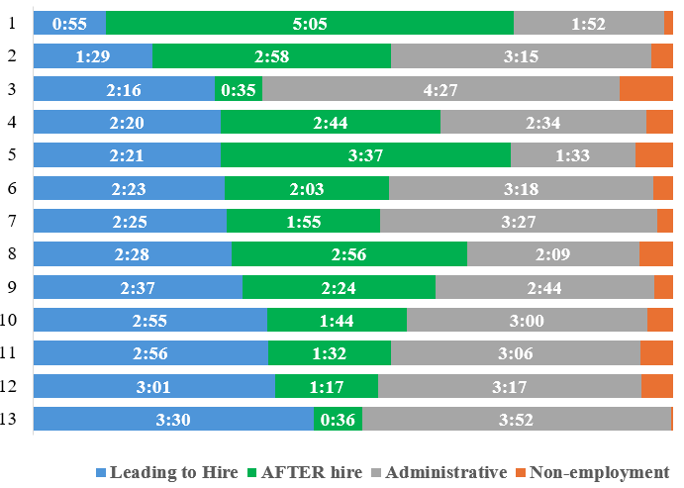
Tracking Our Investments in People’s Careers (cont.)

Slide 10

Try ES-Coach for Free!
Thanks to the Kessler Foundation, your organization can access ES-Coach at no cost until June 2025.
ES-Coach equips your team with:
  Visualizing your service delivery
  Daily microlearning
  Coaching Support
Questions? Email info@es-coach.org.

Slide 11
Tracking Our Investments in People’s Careers:
Weekly Service Delivery Report Scoreboard
(Jeff’s inelegant but effective method)
Name: | Goal: | Actual: | Variance:
Jeff | 5 | 5 | +
Kyle | 20 | 24.75 | +4.75
Tom | 15 | 18.25 | +3.25
Lacey | - | - | -
Ethan | 20 | 14 | (6)
James | 20 | 22.5 | +2.5
Notes:
Edit. Show the plus or minus.
You need to measure effort, not just measure

Slide 12



The WHAT Still Matters!
Staying on Goal
Establishing & Reinforcing Scoreboards
Setting challenging but achievable placement goals for clients
Reinforcing goals without being too discouraging
“Jeff is pushy, but not too pushy.”
- Liam

Slide 13
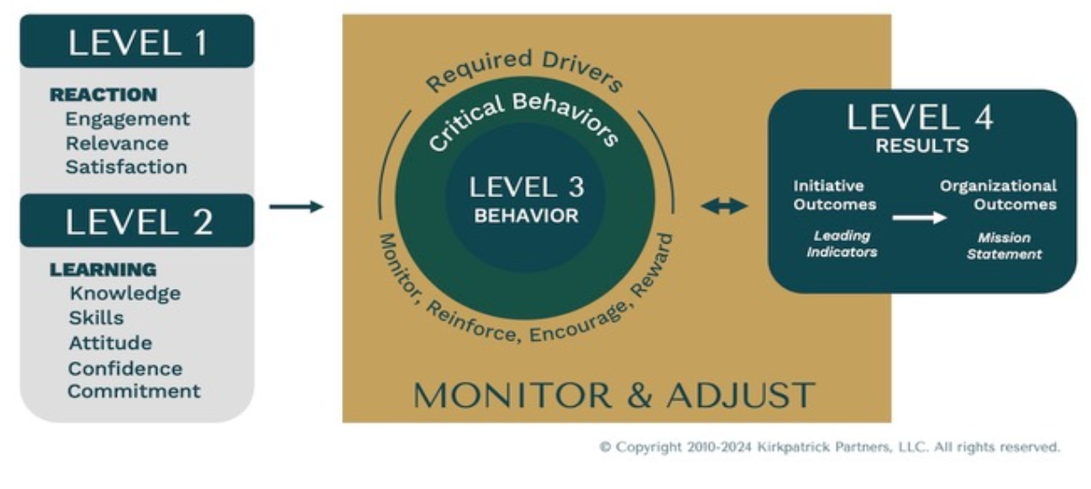
Kirkpatrick Model for Training Evaluation

Slide 14

Learning, Behavior Change, Outcomes
LEARNING
BEHAVIOR
CHANGE
OUTCOMES
DESIRED OUTCOMES | BEHAVIOR CHANGE | LEARNING NEEDED
High employer engagement | Increased tracking of progress in engaging employers | Process for inputting progress notes Skills for writing notes with clarity & confidence Understanding of employer engagement goals
Efficient operations | Daily tracking of service delivery report data | Data entry skills Understanding of organizational workflow
Identify your own examples.

Slide 15
Finding Time for Training
Making time builds positive momentum: staff retention, engagement, outcomes
  Plan breakout session at orientation (or during initial weeks of onboarding) for new employment staff
  Work through a topic each month at staff meeting
  Embed the tools in operations (guidebook, scorecard, SDR, share data regularly); model the practices yourself
  Promote just-in-time learning for problem solving
  Use 1:1 supervision sessions (individualized and self-directed; link to their life experience; link to problem solving; motivations clear)

Slide 16
Questions, Discussion, and Resources
?

